Slide 1
第4章：进化树构建的概率方法
问题介绍
进化树构建方法的概率方法
部分Slides修改自University of Basel的Michael Springmann课程“CS302 Seminar Life Science Informatics”的讲义

Slide 2
Phylogenetic Tree
branch
internal node
leaf
Topology: bifurcating
Leaves - 1…N
Internal nodes N+1…2N-2
Branch length

Slide 3
Molecular Clock Hypothesis
Amount of genetic difference between sequences is a function of time since separation.
Rate of molecular change is constant (enough) to predict times of divergence

Slide 4
Likelihood of a Tree
Given:
n aligned sequences M= X₁,…,X_{n}
A tree T, leaves labeled with X₁,…,X_{n}
Reconstruction t*:
Labeling of internal nodes
Branch lengths
Goal: Find optimal reconstruction t* : One maximizing the likelihood P(M|T, t*)

Slide 5
Probabilistic Methods
The phylogenetic tree represents a generative probabilistic model (like HMMs) for the observed sequences.
Background probabilities: q(a)
Mutation probabilities: P(a|b, t)
Models for evolutionary mutations
Jukes Cantor
Kimura 2-parameter model
Such models are used to derive the probabilities

Slide 6
Probabilistic Model
Assumptions:
Each character is independent
The branching is a Markov process: The probability that a node x has a specific label is only a function of the parent node y and the branch length t between them
The probabilities P(x|y,t) are known

Slide 7
Example
Given then tree

Slide 8
Molecular Evolution
Q: How can we model evolution on nucleotide level? (ignore gaps, focus on substitutions)
A: Consider what happens at a specific position for small time interval Δt
P(t) = vector of probabilities of {A,C,G,T} at time t
μ_{AC} = rate of transition from A to C per unit time
μ_{A} = μ_{AC} + μ_{AG} + μ_{AT} rate of transition out of A
p_{A}(t+Δt) = p_{A}(t) – p_{A}(t) μ_{A} Δt + p_{C}(t) μ_{CA} Δt + …
Notes:
8

Slide 9
Molecular Evolution
In matrix/vector notation, we get
where Q is the substitution rate matrix
Notes:
9

Slide 10
Molecular Evolution
This is a differential equation:
P’(t) = Q P(t)
A substitution rate matrix Q implies a probability distribution over {A,C,G,T} at each position, including stationary (equilibrium) frequencies π_{A}, π_{C}, π_{G}, π_{T}
Each Q is an evolutionary model (some work better than others)
Notes:
10

Slide 11
Mutation Probabilities
P(t) satisfy the following two property:
Lack of memory:
Reversibility:
Exist stationary probabilities {P_{a}} s.t.
A
C
G
T

Slide 12
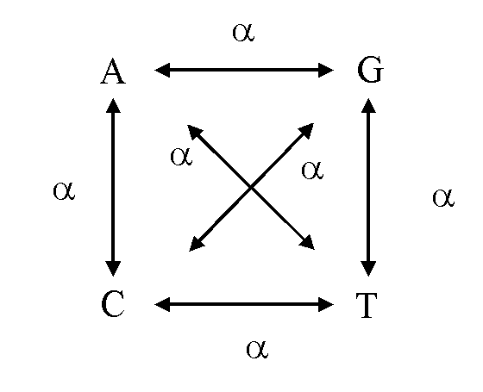
Jukes Cantor model
Mutation occurs at a constant rate
Each nucleotide is equally likely to mutate into any other nucleotide with rate a.

Slide 13
Substitution Matrix
由对称性，可设
又由其满足的微分方程

Slide 14
Substitution Matrix
可得方程
容易求得

Slide 15
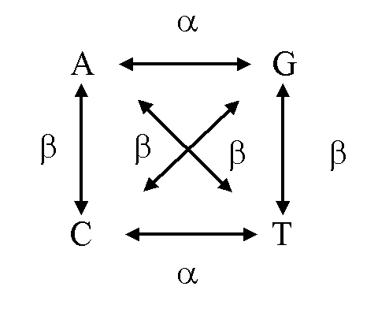
Kimura 2-parameter Model
Allows a different rate for transitions and transversions.

Slide 16
Substitution Matrix
由对称性，可设
又由其满足的微分方程

Slide 17
Substitution Matrix
可得方程
容易求得

Slide 18
Substitution Matrix: General Case
对于对称矩阵Q可以对角化, 即存在正交矩阵U, 和特征值 , 使得
于是

Slide 19
PAM矩阵
Point accepted mutation (Dayhoff et al 1978)
Given an tree of protein family, the frequence matrix A_{ab} counting the occurrence of an “a” in the ancestral sequence was replaced by a “b” in the descendant.
Estimate the conditional probability p(b|a)

Slide 20
PAM矩阵
Scaling B
Such that the expected number of substitution is 1%, i.e.
Then the PAM(1) matrix is given by

Slide 21
Calculating the Likelihood for Ungapped Alignments
假设突变符合JC model, 等初始概率
其中n1是匹配数，n2是不匹配数目.

Slide 22
Calculating the Likelihood for Ungapped Alignments
n sequences of length N, site u=1...N
Given a rooted tree contains 2n - 1 nodes, 1... n being the leaf nodes, n+1 ... 2n-1 non-leaf, tree lengths t1, …, t_{2n-1}.
Let a(i) denote the ancestor of node a^{i}

Slide 23
Felsenstein’s Recursive Algorithm
Let P(L_{k}|a) denote the probability of all the leafs below node k given that the residue at k is a.
Then we compute P(L_{k}|a) from the probabilities P(L_{i} | b) and P(L_{j} |c) for all b and c, where i and j are the daughter nodes of k.
k
a
i
j
b
c

Slide 24
Felsenstein’s Recursive Algorithm
Initialization: set k=2n-1
Recursion: Compute P(L_{k} | a) for all a as follows:
If k is leaf node: P(L_{k}|a)=1 only if
If k is not a leaf node:
Compute P(L_{i}|a), P(L_{j}|a) for all a at the daughter nodes i,j , and set
Temination: Likelihood at site u,

Slide 25
Reversibility & Independence of Root Position
The score of the optimal tree is independent of the root position if and only if:
- the substitution matrix is multiplicative
- the substitution matrix is reversible
A substititution matrix is reversible if for all a,b and t:

Slide 26
Maximum Likelihood (ML)
Score each tree by
Assumption of independent positions “m”
Branch lengths t can be optimized
Gradient Ascent
EM
We look for the highest scoring tree
Exhaustive
Sampling methods (Metropolis)

Slide 27
Computational Problem
Such procedures are computationally expensive!
Computation of optimal parameters, per candidate, requires non-trivial optimization step.
Spend non-negligible computation on a candidate, even if it is a low scoring one.
In practice, such learning procedures can only consider small sets of candidate structures

Slide 28
参考文献
S. Durbin, S. Eddy, A. Krogh and G. Mitchison. Biological Sequence Analysis—Probabilistic Models of Proteins and Nucleic Acids. 1998, Cambridge University Press.

